Slide 1


Covid-19 Vaccine Application Project
Capgemini certified JAVA –Full Stack Developer course
Back-End Project ON Vaccine Application
Presented by :
Ramya chittimalla
EBEON0621384489
2021-5724

Slide 2
OUTLINES:
Objectives.
System Requirements.
Description.
Screenshots.
Feature scope and conclusion.

Slide 3
OBJECTIVES:
The main objective of this project to Design Covid-19 Vaccination Portal using Java and JDBC technology.
This Project has categorised into Two different types of Modules.
Admin ,User Modules.
The user has to Register before they has to Book Vaccine slot.
This Projects is only for Back-end Development.

Slide 4
SYSTEM REQUIREMENTS:
Software used:
operating system used: Windows 7,8,10 .
Tools used: eclipse editor ,MySQL.
Hardware used
Laptop or desktop
Minimum 4gb ram
Language Used:
1.Java.
2.JDBC.
3.SQL.

Slide 5
DESCRIPTION:
Covid19 Vaccine portal:
Vaccine portal is used to Book Vaccination Slots, we have Co-win app in our real time scenario.
Based real time scenario. I have designed these project using Java, JDBC technology.
Based on User given data it Stores details of Users in a Database .It responses end gives Vaccine Application number and 1st Slot vaccine slot Date and 2nd Slot vaccine slot.

Slide 6
Admin Section : USER Section:
Admin is responsible for:
User is Responsible for :
1.Registration
2.Login / Booking to Vaccine slot.
Insert Vaccines.
Show stock of Vaccines.
Update Vaccines.
Shows Registered Applicants.
Vaccine slot Booked candidates.

Slide 7
Java Classes used:
Database's Used:
1. Admin.java
2. User.java
3. V_Booking.java
4. Date_Slot java
5. ApplicationNum.java
CoonctionDb.java
LandingPortal.java
administration.
users.
3. Booking.

Slide 8
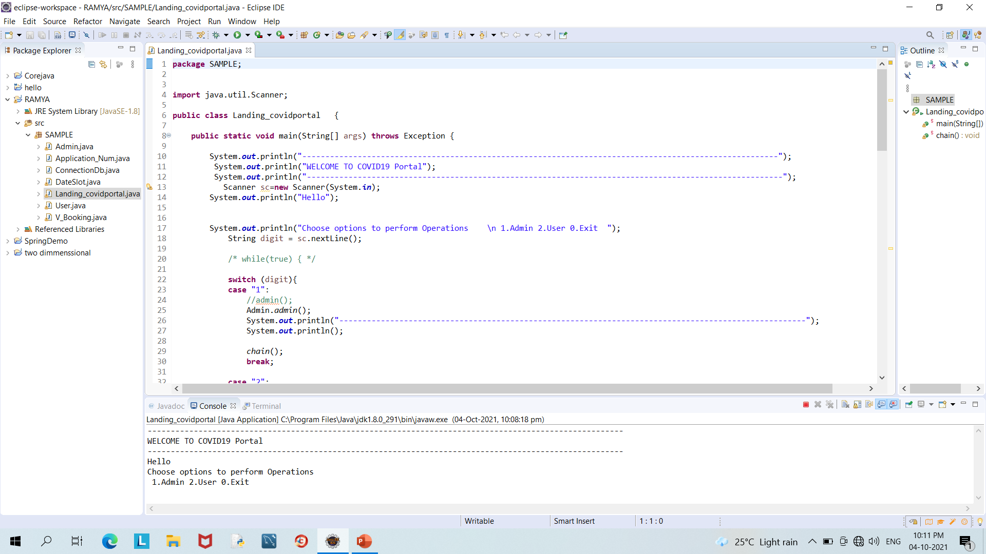
Landing PAGE:

Slide 9
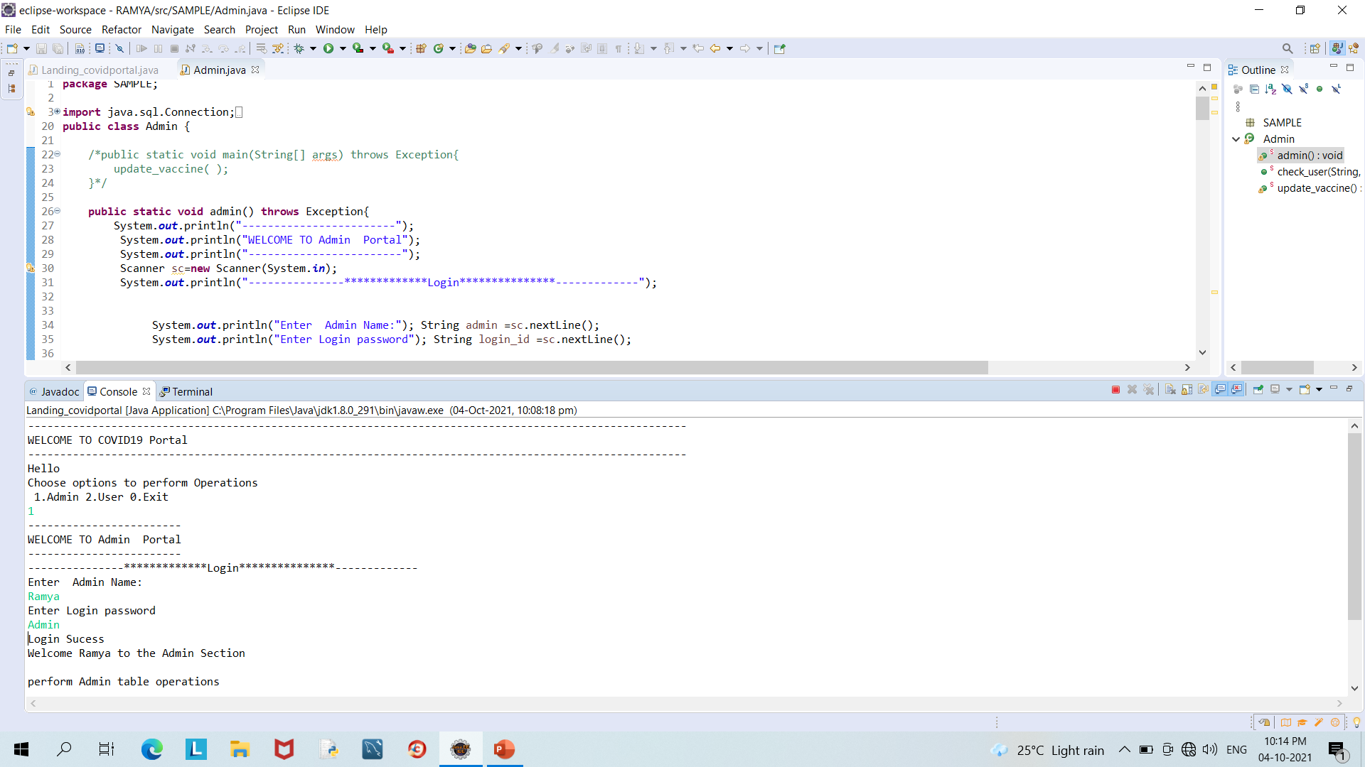
Admin operations:

Slide 10
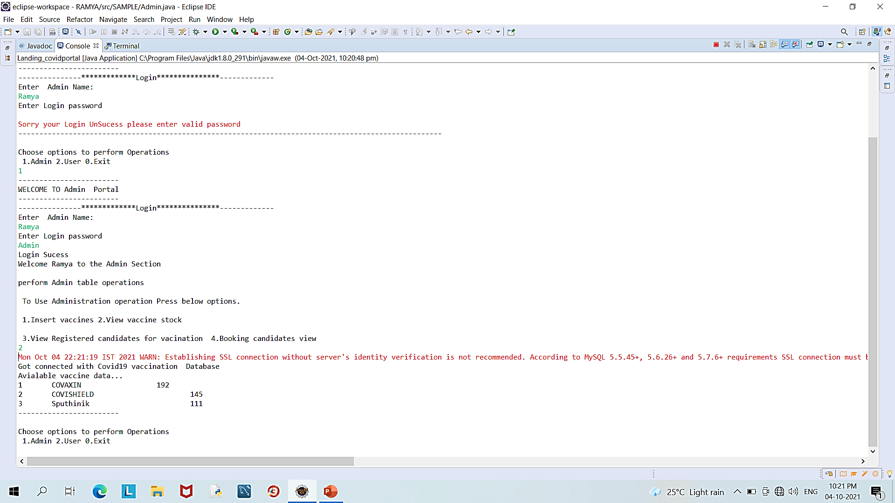
Here option 2 showing stock of vaccines available in database.

Slide 11
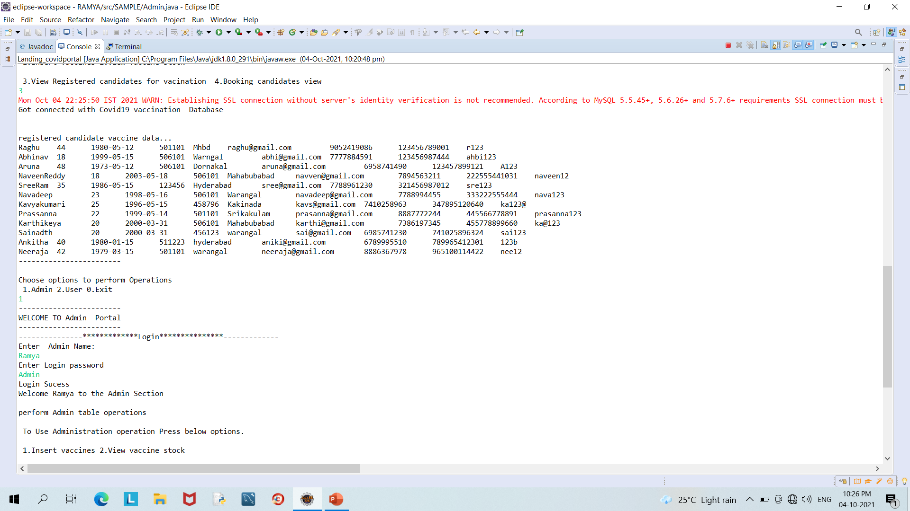

Slide 12
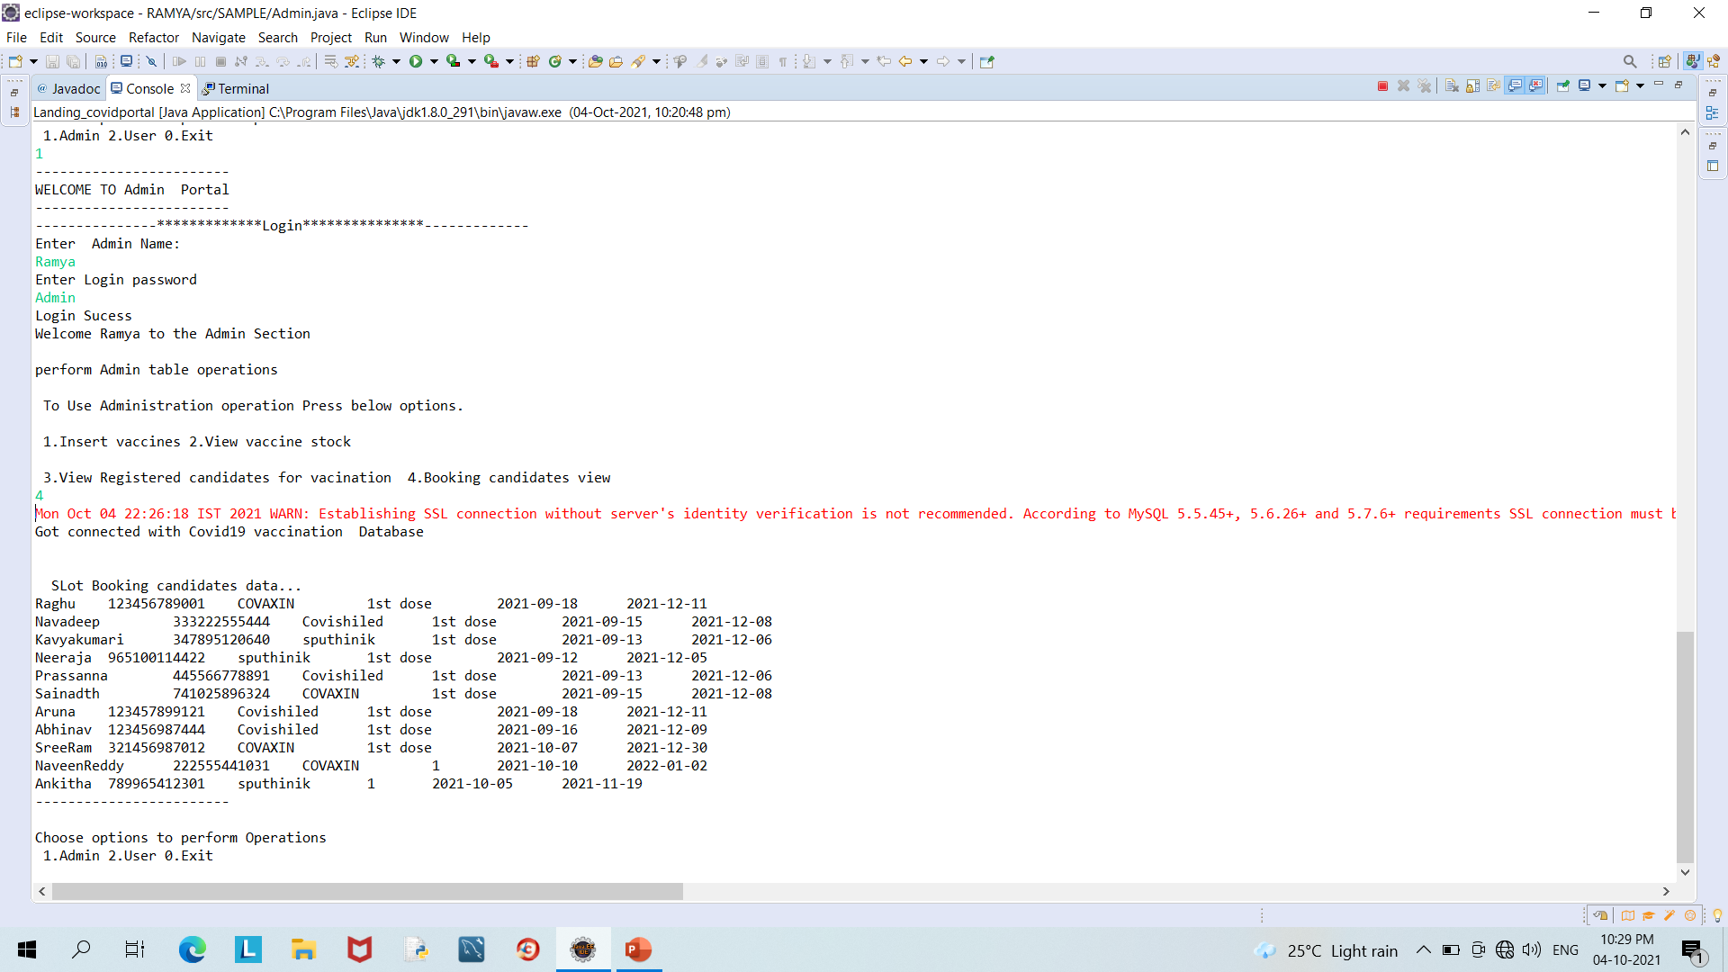
Booking candidates List:

Slide 13
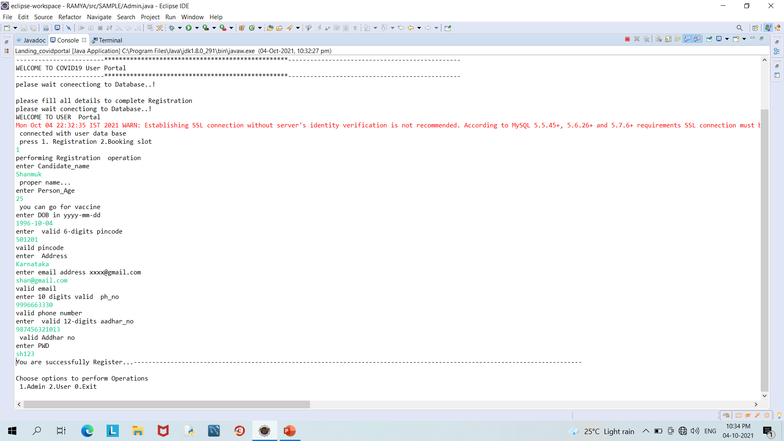
User Operations:
It Showing Registration process of a User

Slide 14
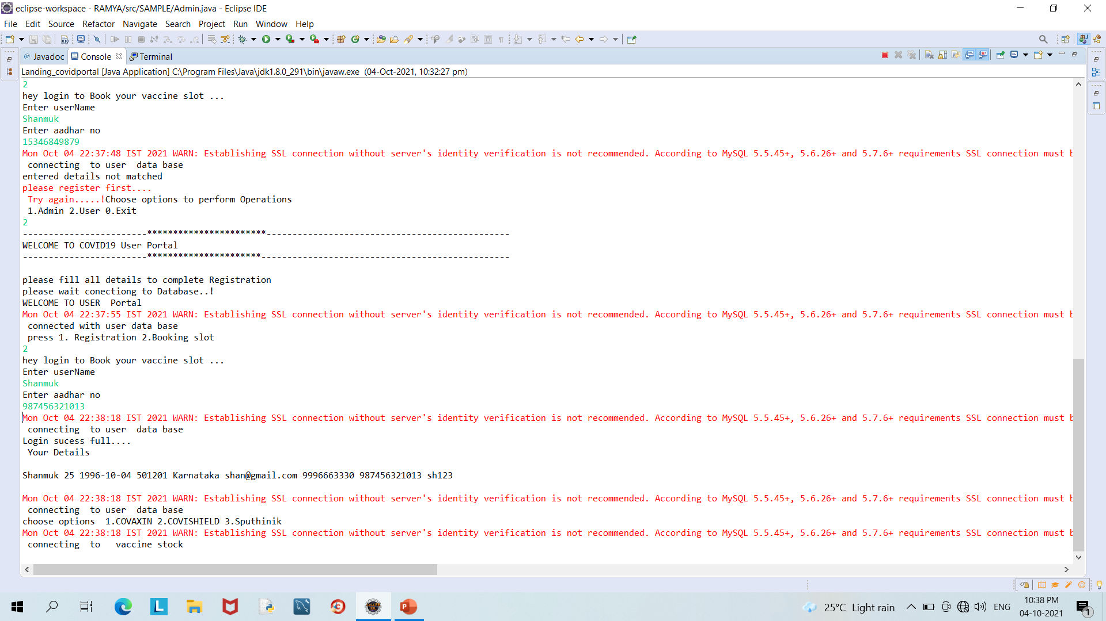
Here User Booking Vaccine slot

Slide 15
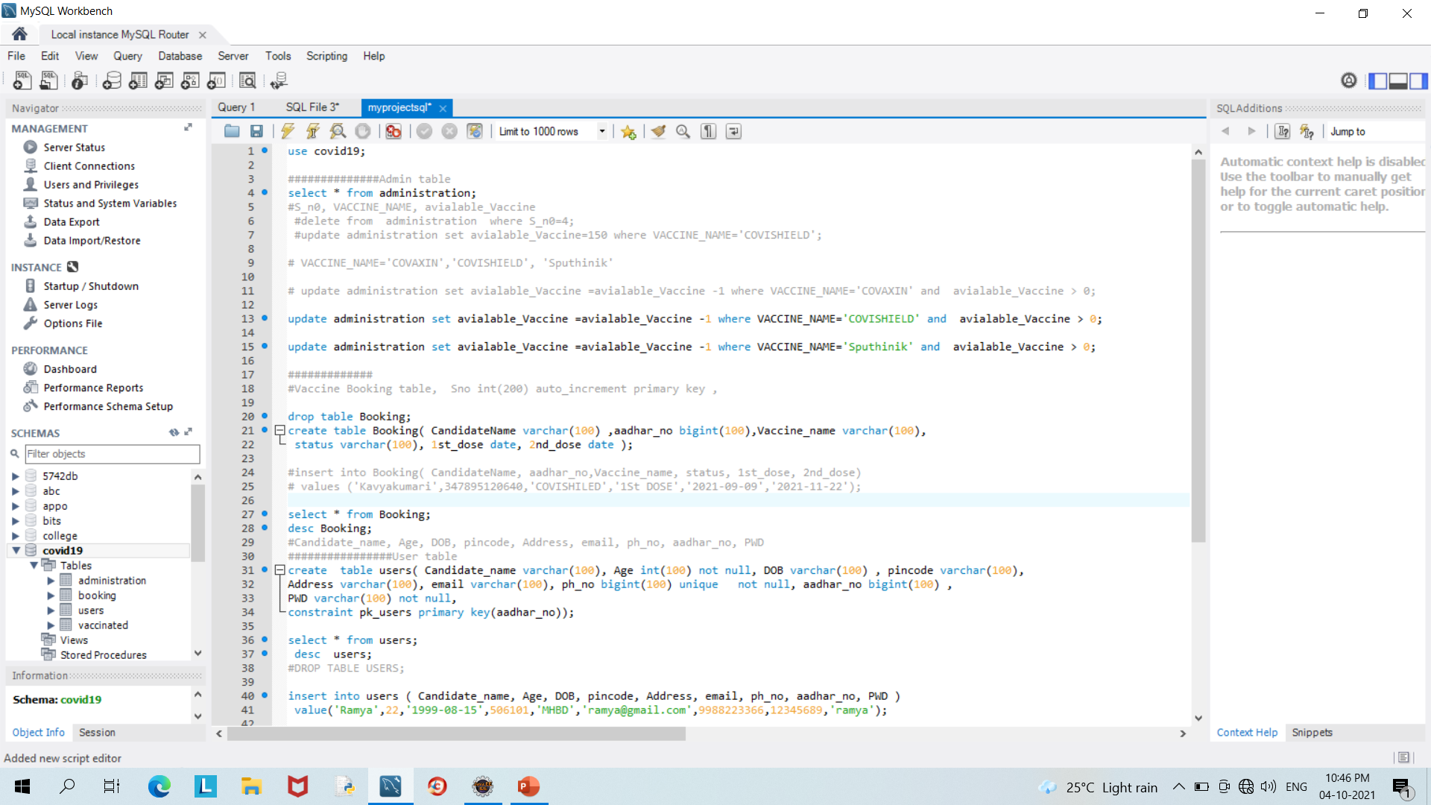
Database setup page:

Slide 16
FUTURE –SCOPE:
Now I have only developed Only 1st slot Vaccination booking process only.
In future we will come with 2nd dose Booking with certificate Generation.

Slide 17
CONCLUSION:
The Covid portal Helps users to Registration and Book vaccination slots. Admin have control authority.

Slide 18

Thank you

